Slide 1
BCT 2310: Automata theory
Lecturer: Mrs. Martha Gichuki
Email ID: mgichuki@jkuat.ac.ke

Slide 2
Turing Machines (TMs)
These are the most powerful computational machines.
They possess an infinite memory in the form of a tape, and a head which can read and change the tape, and move in either direction along the tape.
Turing machines are equivalent to algorithms and are the theoretical basis for modern computers.
Turing machines decide recursive languages and recognize the recursively enumerable languages.
Turing Machines have the essential feature of unrestricted access to limited memory, distinguishing them from weaker models like FA and PDA.

Slide 3
Formal Definition of a Turing Machine
A Turing Machine is a 7-tuple (Q, ∑, Γ, δ , q₀, q_{accept,} q_{reject}), where
Q is a finite set of states
∑ is the input alphabet – blank symbol (∪) not included
Γ is the tape alphabet
δ: Q X Γ → Q X Γ X {L, R} is the transition function
q₀ ∈ Q is the start state
q_{accept,} ∈ Q is the Accept state, and
q_{reject} ∈ Q is the Reject state.

Slide 4
Example 1:
Given a Turing machine M₆, which recognizes the language consisting of all strings of 0s whose length is a power of 2? It decides the language A = {0^{2n} | n>=0}. E.g. 2⁰, 2¹, 2², 2³ …2^{n. {}0, 00, 0000, and 00000000 …}
The formal definition of M₆ = (Q, ∑, Γ, δ, q₁, q_{accept}, q_{reject}). Where;
Q = {q1, q2, q3, q4, q5, q_{accept}, q_{reject}};
∑ = {0};
Γ = {0, x, U};
q₁ = Start State;
q_{accept} = Accept State and
q_{reject =} Reject State
is described using the state diagram below:-

Slide 5
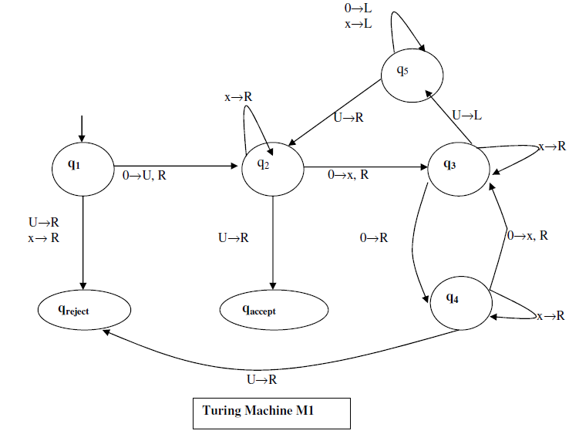

Slide 6
Show that the language 00 is accepted by machine M₆
q₁00∪∪∪…
∪q₂0∪∪∪…
∪ xq₃∪∪∪…
∪ q₅x∪∪∪…
∪ q₅∪x∪∪∪…
∪ q₂x∪∪∪…
∪ x q₂∪∪∪…
∪ x∪ q_{accept}

Slide 7
Show that the language 000 is not accepted by machine M₆
q₁000∪∪∪…
∪q₂00∪∪∪…
∪ xq₃0∪∪∪…
∪x0q₄∪∪∪…
∪x0∪ q_{reject} ∪∪…

Slide 8
Show that the language 0000 is accepted by machine M₆
q₁0000∪∪∪…
∪q₂000∪∪∪…
∪ xq₃00∪∪∪…
∪ x0q₄0∪∪∪…
∪x0x q₃∪∪∪…
∪x0 q₅ x ∪∪∪…
∪x q₅0x ∪∪∪…
∪ q₅ x0x ∪∪∪…
q₅ ∪x0x ∪∪∪…
∪ q₂ x0x ∪∪∪…
∪ x q₂ 0x ∪∪∪…
∪ xx q₃ x ∪∪∪…
∪ xx x q₃ ∪∪∪…
∪ xx q₅x ∪∪∪…
∪ x q₅ xx ∪∪∪…
∪ q₅ xx x ∪∪∪…
q₅ ∪ xx x ∪∪∪…
∪ q2 xx x ∪∪∪…
∪ xq2 x x ∪∪∪…
∪ xx q2 x ∪∪∪…
∪xx xq2 ∪∪∪…
∪ xx x ∪q_{accept}

Slide 9
Assignment:
Show whether the following strings are accepted or rejected by the Turing Machine
i). 0
ii). 00000
iii). 000000

Slide 10
Variants of Turing Machines: -
Multi-tape Turing Machine – Has several tapes, each with its own head for reading and writing
Enumerator – Has a printer attached to it.
Non-Deterministic Turing Machine – At any point, the machine may proceed according to several possibilities
Summary:
Finite Automata can either be DFA or NFA.
There are other extensions of FA including the PDA and the TM among others.

Slide 11
A CFG defines a Context Free Language (CFL) which is recognized by a PushDown Automata.
Context Free
Push Down
Grammar (CFG)
Automata (PDA)
Describes
Recognizes
Context
Free
Language (CFL)

Slide 12
Questions????
Comments

